Slide 1
Cartographer SLAM Tutorial
我不生产知识，我只是知识的搬运工
2021-03-31
https://github.com/CCDreamOldBoys/Lidar-SLAM-tutorial
AAutonomous Cleaning Equipmentutonomous Cleaning Equipment
quandy@outlook.com

Slide 2
Contents
Linear Algebra
Gaussians
Kalman
EKF
UKF
PF
G2O
Ceres
CMake
C++11/14
Ubuntu

Slide 3
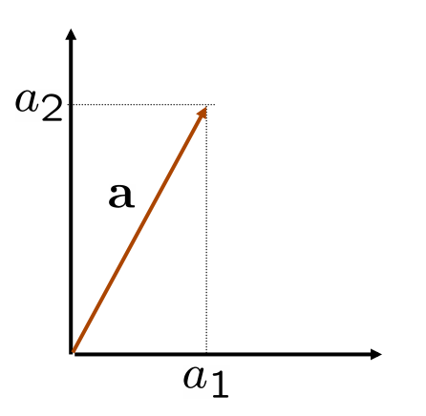
Linear Algebra
Vectors
Arrays of numbers
Vectors represent a point in a dimensional space
http://bicmr.pku.edu.cn/~wenzw/bigdata/matrix-cook-book.pdf

Slide 4
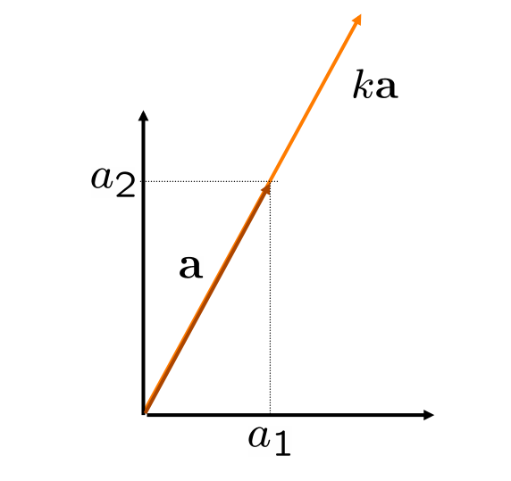
Linear Algebra
Vectors Scalar Product
Scalar-Vector Product
Changes the length of the vector, but not its direction

Slide 5
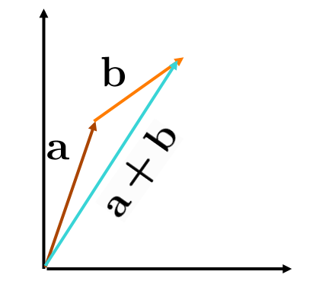
Linear Algebra
Vectors: Sum
Sum of vectors (is commutative)
Can be visualized as “chaining” the vectors.

Slide 6
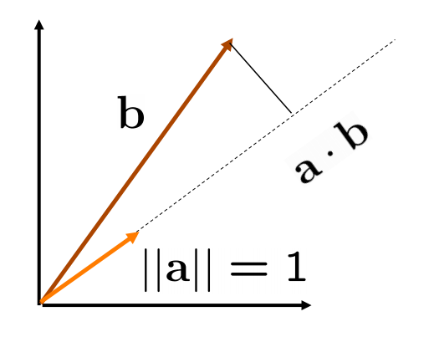
Linear Algebra
Vectors: Dot Product
Inner product of vectors (is a scalar)
If one of the two vectors, e.g. , has ,the inner product returns the length of the projection of along the direction of a
If , the two vectors are orthogonal

Slide 7
Linear Algebra
Matrices
A matrix is written as a table of values
1st index refers to the row
2nd index refers to the column
Note: a d-dimensional vector is equivalent to a dx1 matrix

Slide 8
Linear Algebra
Matrices as Collections of Vectors
Column vectors

Slide 9
Linear Algebra
Matrices as Collections of Vectors
Row vectors

Slide 10
Linear Algebra
Important Matrices Operations
Multiplication by a scalar
Sum (commutative, associative)
Multiplication by a vector
Product (not commutative)
Inversion (square, full rank)
Transposition

Slide 11
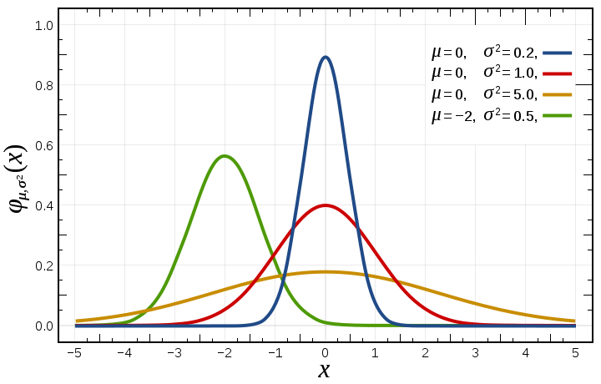
Gaussians
Univariate Gaussians
https://zh.wikipedia.org/wiki/File:Normal_Distribution_PDF.svg

Slide 12
Gaussians
Multivariate Gaussians

Slide 13
Gaussians

Slide 14
Cartographer
XYIndexRangeIterator

Slide 15
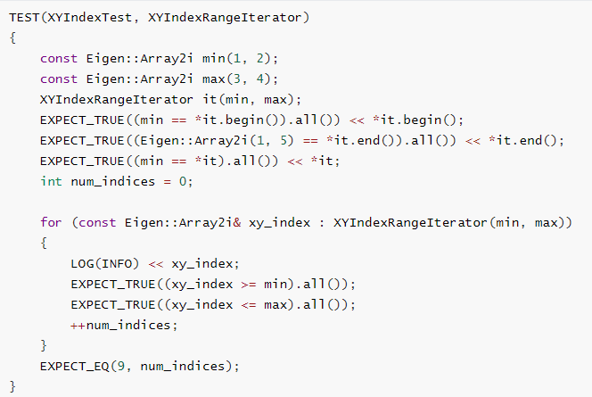
Cartographer
XYIndexRangeIterator

